Slide 1
Let’s go luggage
Shuang zhang

Slide 2
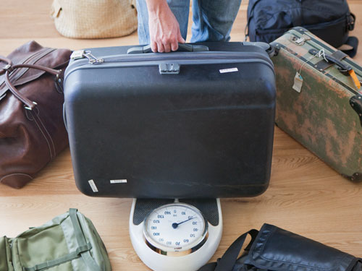
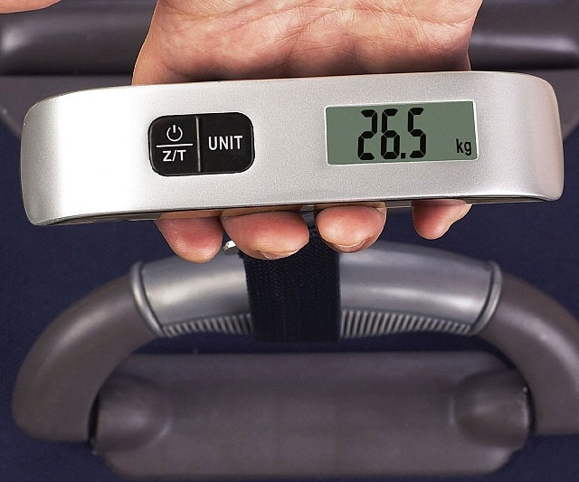
Demand
When do people need to know the weight of a luggage?

Slide 3
Features
Lift it up to know weight and fees
Simple to use without training
Connect to the Internet only when it’s necessary

Slide 4
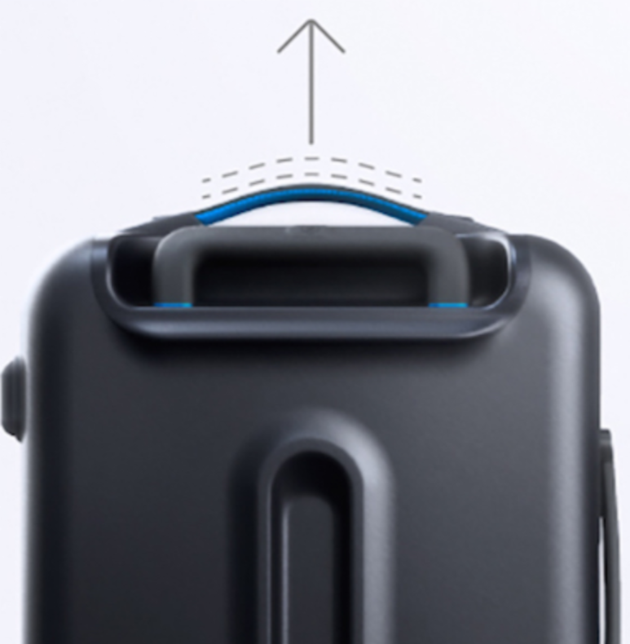
Features

Slide 5


System model
Internet
Get airlines policy
Calculate fees

Slide 6
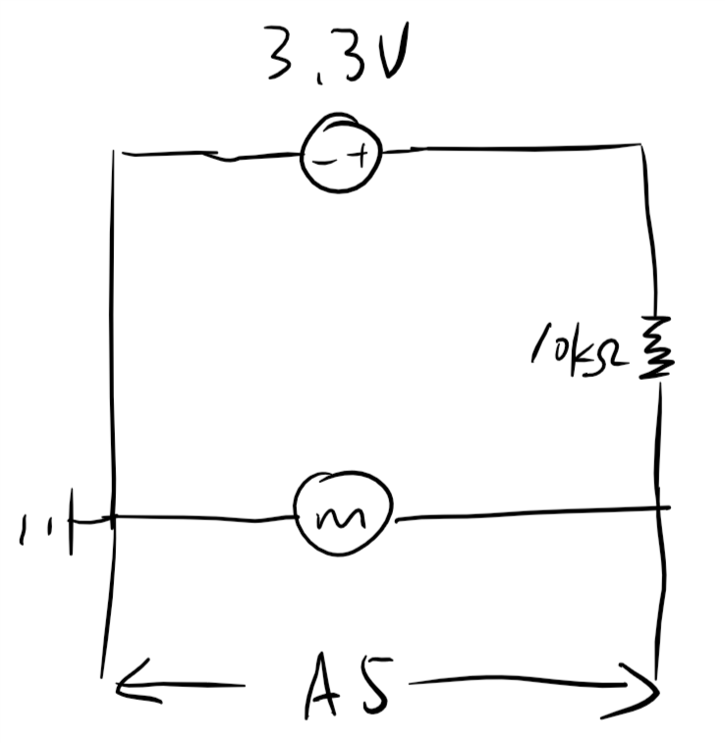
Circuit

Slide 7
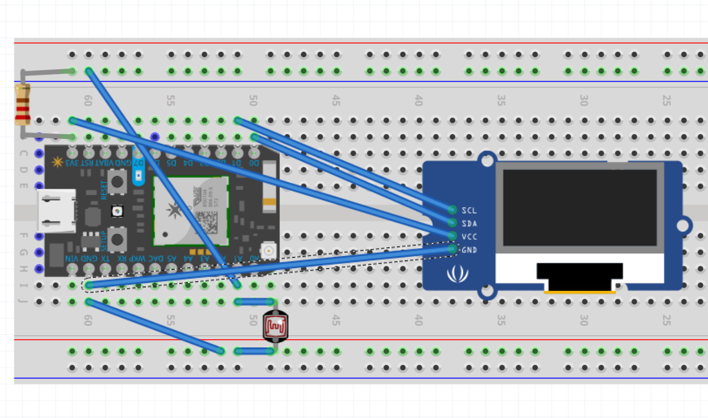
Circuit

Slide 8
Scalability
Almost the same as normal luggage
Servers don’t do heavy works

Slide 9
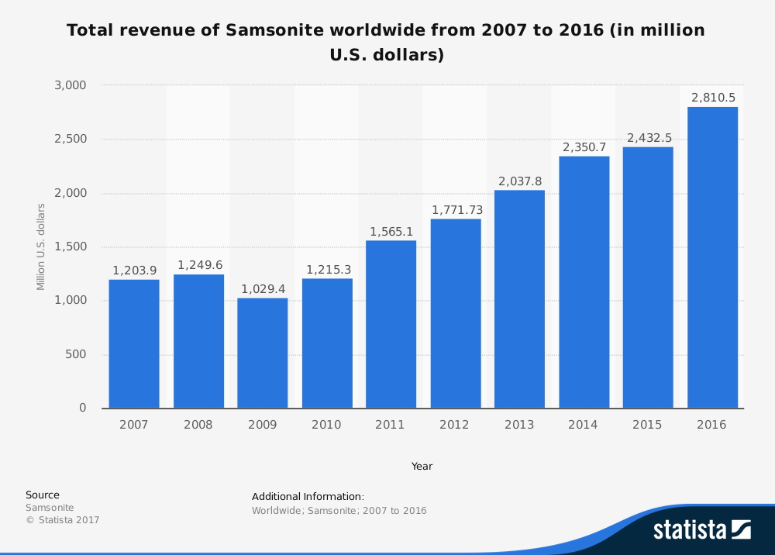
Market

Slide 10
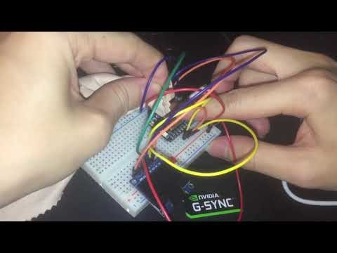
Demonstration

Slide 11
Code
https://github.com/zsbenq/IoT

Slide 12
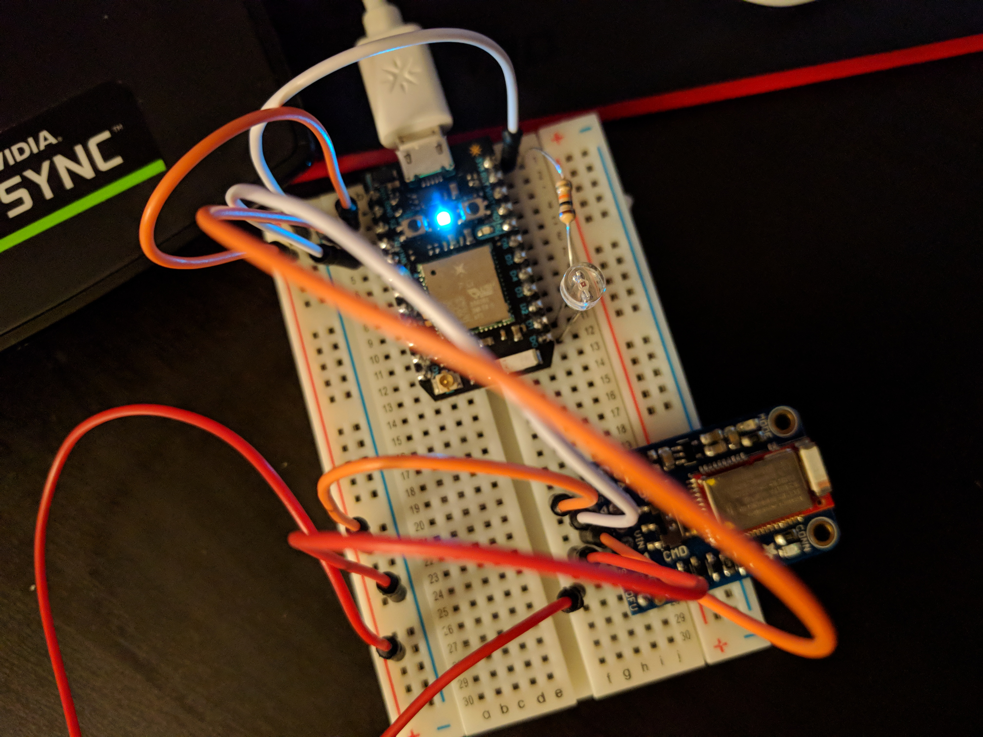
Questions?

